Slide 1

New Methods and Proposals for Evaluating Soundscape Designs and Interventions
Dr Andrew Mitchell
Senior Research Fellow in Soundscape Modelling
Institute for Environmental Design and Engineering, UCL

Slide 2
“In practice, noise abatement is a reactive approach to sound. […] This makes noise abatement comparable to waste management. Sound is deemed a harmful waste product of human activity that must be removed.”
-- Östen Axelsson (2020)
1 Axelsson, Ö. (2020, August). Soundscape revisited. Journal of Urban Design, 25(5), 551-555. doi: 10.1080/13574809.2020.1810006

Slide 3
Introduction – what is (a) soundscape?
Soundscape is normatively defined by ISO 12913-1:2014 as:
an acoustic environment as perceived or experienced and/or understood by a person or people, in context
It is important to make sure we are all talking about the same thing when we call something a soundscape

Slide 4
Three key definitions
ISO 12913-1 – Acoustic Environment:
sound at the receiver from all sound sources as modified by the environment
Note: Acoustic environment can be actual or simulated, outdoor or indoor, as experienced or in memory
Soundscape Ecology:
All sounds, those of biophony, geophony, and anthrophony, emanating from a landscape to create unique acoustical patterns across a variety of spatial and temporal scales
ISO 12913-1 - Soundscape:
The acoustic environment as perceived or experienced, by a person or people, in context
Notes:
Acoustic Environment - In contrast, the soundscape considers the acoustic environment, but also considers the impact of non-acoustic elements, such as the listener’s context and the visual setting, and how these interact with the acoustic environment to influence the listener’s perception. This approach brought the definition closer to Schafer’s original idea where a soundscape consists of culturally conditioned elements, as perceived by him.

Slide 5
Distal, Proximal, and Perceptual
Many of these conceptions of soundscape can actually be organized into different types of soundscapes:
Distal, Proximal, and Perceptual Soundscapes as defined by Grinfeder et al. (2022)
Grinfeder, Elie, Christian Lorenzi, Sylvain Haupert, and Jérôme Sueur. 2022. “What Do We Mean by "Soundscape"? A Functional Description.” Frontiers in Ecology and Evolution 10 (June). https://doi.org/10.3389/fevo.2022.894232.

Slide 6
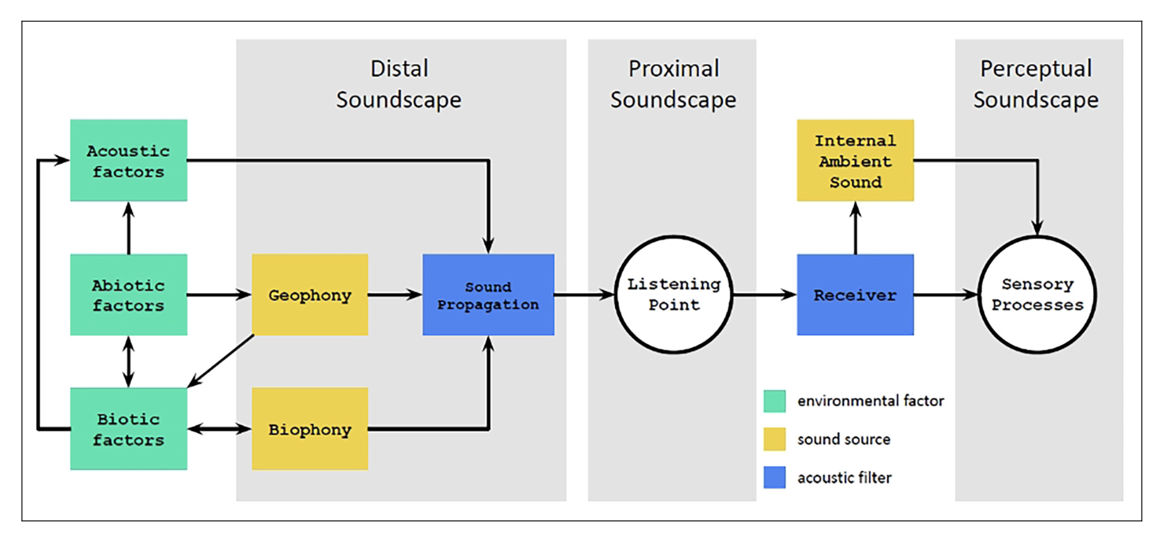
Distal, Proximal, and Perceptual
Distal: “the spatial and temporal distribution of sounds in a prespecified area”; a theoretical construct which encompasses all the sound signals which arise within a given area.
Soundscape Ecology: All sounds emanating from a landscape
Lorenzi, Christian, Frédéric Apoux, Elie Grinfeder, Bernie Krause, Nicole Miller-Viacava, and Jérôme Sueur. 2023. “Human Auditory Ecology: Extending Hearing Research to the Perception of Natural Soundscapes by Humans in Rapidly Changing Environments.” Trends in Hearing 27 (January). https://doi.org/10.1177/23312165231212032.
Notes:
Distal – Soundscape Ecology/Pijanowski: Encompassing all sources across a variety of spatial and temporal scales in a space. There is only a single distal soundscape, but it only exists as a theoretical construct
“In the same way that a landscape event cannot be assimilated to a singular signal, the distal soundscape cannot be represented by the acoustic information at any single receiver.”
Proximal – ISO Acoustic Environment. Whereas the distal soundscape is theoretical, singular for a space, and cannot be measured, proximal soundscapes can be measured and a unique proximal soundscape exists for every potential receiver.
Perceptual – ISO Soundscape
“The individual subjective interpretation of a proximal soundscape”
Just because we can’t measure the perceptual soundscape of animals, doesn’t mean it doesn’t exist. Is that enough of a reason to entirely exclude it (and with it the entire field of soundscape ecology) from the definition of soundscape?

Slide 7
Distal, Proximal, and Perceptual
Proximal: the collection of sound signals at a particular receiver, after propagating throughout the environment
Acoustic Environment: Sound at the receiver
Lorenzi, Christian, Frédéric Apoux, Elie Grinfeder, Bernie Krause, Nicole Miller-Viacava, and Jérôme Sueur. 2023. “Human Auditory Ecology: Extending Hearing Research to the Perception of Natural Soundscapes by Humans in Rapidly Changing Environments.” Trends in Hearing 27 (January). https://doi.org/10.1177/23312165231212032.
Notes:
Distal – Soundscape Ecology/Pijanowski: Encompassing all sources across a variety of spatial and temporal scales in a space. There is only a single distal soundscape, but it only exists as a theoretical construct
“In the same way that a landscape event cannot be assimilated to a singular signal, the distal soundscape cannot be represented by the acoustic information at any single receiver.”
Proximal – ISO Acoustic Environment. Whereas the distal soundscape is theoretical, singular for a space, and cannot be measured, proximal soundscapes can be measured and a unique proximal soundscape exists for every potential receiver.
Perceptual – ISO Soundscape
“The individual subjective interpretation of a proximal soundscape”
Just because we can’t measure the perceptual soundscape of animals, doesn’t mean it doesn’t exist. Is that enough of a reason to entirely exclude it (and with it the entire field of soundscape ecology) from the definition of soundscape?

Slide 8
Distal, Proximal, and Perceptual
Perceptual: the individual subjective interpretation of a proximal soundscape
ISO Soundscape: Acoustic Environment as perceived
Lorenzi, Christian, Frédéric Apoux, Elie Grinfeder, Bernie Krause, Nicole Miller-Viacava, and Jérôme Sueur. 2023. “Human Auditory Ecology: Extending Hearing Research to the Perception of Natural Soundscapes by Humans in Rapidly Changing Environments.” Trends in Hearing 27 (January). https://doi.org/10.1177/23312165231212032.
Notes:
Distal – Soundscape Ecology/Pijanowski: Encompassing all sources across a variety of spatial and temporal scales in a space. There is only a single distal soundscape, but it only exists as a theoretical construct
“In the same way that a landscape event cannot be assimilated to a singular signal, the distal soundscape cannot be represented by the acoustic information at any single receiver.”
Proximal – ISO Acoustic Environment. Whereas the distal soundscape is theoretical, singular for a space, and cannot be measured, proximal soundscapes can be measured and a unique proximal soundscape exists for every potential receiver.
Perceptual – ISO Soundscape
“The individual subjective interpretation of a proximal soundscape”
Just because we can’t measure the perceptual soundscape of animals, doesn’t mean it doesn’t exist. Is that enough of a reason to entirely exclude it (and with it the entire field of soundscape ecology) from the definition of soundscape?

Slide 9
A novel definition of soundscape:
A soundscape is the sonic environment of a place, setting, or community, whose character is the result of the interaction with non-auditory and/or contextual factors.

Slide 10
The Soundscape Approach
The concept of soundscape integrates individuals into the process of assessing and changing acoustic environments based on the perceptions and responses of affected individuals.
It is increasingly apparent that a sound level-oriented perspective cannot capture several relevant aspects of noise and its perception in specific concepts.
Thus, methods have been developed to measure and analyze human perception of sound in context.
B. Schulte-Fortkamp, A. Fiebig, J. A. Sisneros, A. N. Popper, and R. R. Fay, Eds., Soundscapes: Humans and Their Acoustic Environment. Springer International Publishing, 2023. doi: 10.1007/978-3-031-22779-0.
Notes:
The concept of soundscape integrates individuals into the process of assessing and changing acoustic environments based on the perceptions and responses of affected individuals. […] Although traditional environmental and community noise assessments still rely heavily on sound pressure level (SPL) indicators to quantify noise exposure, predict noise annoyance, and derive noise effects, it is increasingly apparent that a sound level-oriented perspective cannot capture several relevant aspects of noise and its perception in specific contexts. Thus, methods have been developed to measure and analyze human perception of sound in context.

Slide 11
How do we bring a soundscape approach into engineering practice?

Slide 12
Engineering Practice
The ability to affect change at large scales and in a wide range of projects will require that familiar engineering tools and approaches can be applied to soundscape design.
If we want to improve on the dB, soundscape needs methods which can take its place and be used in similar ways.
Current methods are generally limited to a post-hoc assessment of the existing environment.
Best practice soundscape design such as co-design or participatory methods are great, but they are typically only applied in dedicated research or high-budget projects.
A predictive model of user’s perceptual response to the acoustic environment is necessary to make soundscape more widely applicable.

Slide 13
Applications in Design and Mapping
The soundscape approach faces several challenges in practical engineering applications which are unaddressed by current assessment methods, but which may be solved through the development of a predictive modelling framework.
Predicting how a change in an existing sound environment will be reflected in the soundscape perception – this relates strongly to the idea of soundscape interventions
Retrospective methods struggle to capture the dynamics of the soundscape in a space.
Survey methods make city-scale mapping of soundscape perception difficult and work-intensive.
Notes:
The first of these challenges is predicting how a change in an existing sound environment will be reflected in the soundscape perception. While it is possible in this scenario to measure the existing soundscape perception via questionnaire surveys, if a change is then introduced to the acoustic environment, it is so far impossible to say what the resulting soundscape change would be. This question relates strongly to the idea of soundscape interventions; where a particular noise pollution challenge is addressed by introducing more pleasant sounds (e.g. a water feature), following the soundscape principle of treating sound as a resource [10, 11]. Predicting how much a particular intervention would improve the soundscape (or, indeed whether it would improve at all) is not yet possible with the retrospective methods available
Retrospective methods also struggle to capture the dynamics of the soundscape in a space. Whether through the narrative interview method of ISO/TS 12913-2 [21], through soundwalks, or through in situ questionnaires [22], only the soundscape during the particular period which the
researchers are actively investigating is captured. This makes it very difficult to determine diurnal, seasonal, or yearly patterns of the soundscape. These patterns may be driven by corresponding diurnal, seasonal, or yearly patterns in the acoustic or visual environment, or by variations in how
people process and respond to the sound at different times of day/season/year. Currently the only way to investigate any of these patterns is through repeated surveys. Predictive modelling, on the other hand, could allow a trained soundscape model to be paired with longterm monitoring methods to
track how a soundscape perception may change in response to changes in the acoustic environment.
Similarly, a move towards modelling methods based on objective and/or measurable factors would facilitate the application of mapping in soundscape. While noise maps have become common in urban noise research and legislation [23, 24], they can be difficult to translate into a soundscape
approach. The Environmental Noise Directive (END) [25], first implemented in 2002, is the main EU instrument to identify noise pollution impacts and track urban noise levels across the EU. Its goals were to determine the population’s exposure to environmental noise, make information on
environmental noise available to the public, and prevent and reduce environmental noise and its effects. In general, noise maps are based on modelled traffic flows, from which decibel levels are extrapolated and mapped, although interpolation and mobile measurement methods have also been
recently developed (see [26]). Alternatively, they can be produced using longterm SLMs or sensor networks. While these methods have significant utility for tracking increases in urban noise levels and are important for determining the health and societal impacts of noise on a large scale, their restricted
focus on noise levels alone limits their scope and reduces the potential for identifying more nuanced health and psychological effects of urban sound.
Urban scale noise mapping and its implementation at the international level has been crucial in highlighting the health impacts of urban noise and in providing evidence for the negative cost of excess noise. Traffic flow models of noise, large community noise surveys, and policy requirements to
track noise levels have all been necessary to reveal these impacts. By creating predictive soundscape models, combined with new tools and sensing capabilities from smart city efforts, we can bring soundscape into these same realms. Without this, these large-scale impact studies will be limited
to valuing the negative cost of urban noise, missing the potential value of positive soundscapes. By bringing perception-based practice to the same scale and type of evidence, we can expand urban sound research to consider a holistic view of urban spaces and their impacts.

Slide 14
The Predictive Soundscape Model Framework
Several forms of predictive models appear in the literature³ using a wide array of algorithms, but also with a variety of types of input data.
This framework is not specific to any particular algorithm – the goal is to create a general framework which defines what characteristics are required of a model to make it useful in the manners discussed earlier.
3 Lionello, M., Aletta, F., & Kang, J. (2020, June). A systematic review of prediction models for the experience of urban soundscapes. Applied Acoustics. 170.

Slide 15
Components of a Predictive Soundscape Model
Soundscape descriptors are measures of how people perceive the acoustic environment – e.g. perceptual attributes
Soundscape indicators are measures used to predict the value of a soundscape descriptor – e.g. LAeq, Loudness, etc.
Soundscape Indices are single value scales derived from either descriptors or indicators that allow for comparison across soundscapes.
2 Aletta, F., Kang, J., Axelsson, Ö. (2016, July). Soundscape descriptors and a conceptual framework for developing predictive soundscape models. Landscape and Urban Planning. 149:65-74.

Slide 16
Goals
Before defining what form a general PSM should take, we first need to make clear what the goals of such a model are:
Accuracy – to a reasonable extent, the model is successful in predicting the collective perception of a soundscape.
Automation – the model can be implemented automatically.
Comparisons – the model should enable us to test, score, and compare proposed interventions and designs.
Notes:
Accuracy – First, that it to a reasonable extent is successful in predicting the collective perception of a soundscape. It should succeed at both indicating the central tendency of the soundscape perception, but importantly it should also inform the likely spread of perception among the population. The outcome of the predictive model should not be focussed on predicting an
individual assessment; the goal is not the predict the perception of any specific individual, but to reflect the public’s perception of a public space. In other words, ideally the model will result in an accurate distribution of soundscape perceptions for the target population.
Automation – Second, that it can be implemented automatically. Once an initial setup is performed, such as identifying what location the measurements are conducted in, the model should be capable of moving from recorded information to predicted soundscape distribution without human intervention. We need soundscape assessments to be able to be performed instrumentally. This enables it to be applied to unmanned uses, such as smart city sensors and soundscape mapping. It is impractical to conduct soundscape surveys or soundwalks in every location we wish to map and certainly not
when we wish to see how these locations change over longer periods of time. A predictive model should allow us to survey these soundscapes remotely in order to extend soundscape to city-scale assessments.
Comparisons – Third, the model should enable us to test, score, and compare proposed interventions. In a design context, it is crucial that various strategies and interventions can be tested and that the influencing factors can be identified. The model should assist the user in highlighting what factor is limiting the success of a soundscape, spark ideas for how to address it, and allow these ideas to be tested. Several other useful features of predictive soundscape models arise out of these goals and will be discussed later, but these form the core goals of the framework.

Slide 17
Constraints
These goals give rise to several constraints which the PSM must contend with:
Inputs – The model must be based on measurable factors.
Calculation – Any analysis of the measured data can be done automatically, without human intervention. For certain applications, this may also relate to computational time.
Generalisability – The model must be generalizable to new locations (but not necessarily new contexts).
Robustness – The model should be robust to missing components
Notes:
Inputs – The first constraint is that the model must be based on measurable factors. By this, we mean that the data which eventually feeds into the predictive model should be collected via sensor measurements of one sort or another; this could be acoustic sound level measurements or recordings, environmental measurements, video recordings, or GIS measurements, etc. What it certainly cannot include is perceptual data. This is strictly a practical constraint – for a predictive model designed
to be used in practice, there is no justification to include other perceptual factors, such as perceived greenness, derived from surveys but not whichever factor you desire to predict. If the goal is to predict soundscape pleasantness and it is necessary to survey people about the visual pleasantness, why not just also survey them about the soundscape pleasantness directly? Certainly this mix of perceptual data is useful in research and can elucidate the relationship between the sonic and visual environments, but it is not useful in a practical predictive context. Any results which arise from research combining this sort of perceptual information must eventually be translated into a component which can itself be measured or modelled.
Calculation – The second constraint is that any analysis of the measured data can be done automatically, without human intervention. If the eventual goal is to deploy the model on continuously-running, unmanned sensor nodes or to enable practical large-scale measurements, the predictive model should be capable of operating with minimal human input. This means, for instance that if the model includes information about the sound source, this identification of the source should
be possible to do automatically (i.e. through environmental sound recognition).
A potential constraint for some applications is related to computation time. Since one proposed application of a predictive soundscape model is to embed the model on a WASN node, the model would then need to be able to run on relatively low-power hardware such as a Raspberry Pi with a reasonable latency. This would especially present an issue for those models which rely on the combination of several psychoacoustic features, since these features are computationally intensive to calculate and several of them may need to be computed for each time step of the model. Although this is a real practical concern that should be addressed in the future, for the sake of this initial definition of a general predictive model used across many applications, we have not considered this a strict constraint.
Generalisability – The third constraint is for the model to be generalisable to new locations. Ideally, it will be generalisable to new and (to it) unfamiliar soundscape types, but the minimum requirement should be that it can be applied to new locations which are otherwise similar to those in the training data. This means that any factors which are used to characterise the context provided by the location should be distinguished from a simple label of the location and should instead be derived from measurements of the location. In practice this could be geographical or architectural characteristics of the space, a proposed use-case of the space, or consistent visual characteristics of the space such as the proportion of pavement to green elements. This is in contrast to the model created in which was constrained to be used only on those locations included in the training data since it made use of a location label.
For this third point, some aspects of the first and second constraints can be relaxed. Since this would only need to be defined once for a location, definitions such as the use case of the space could be defined by the person using the model. What is necessary is that the model and its component location-context factors can be set up ahead of time by the user, then the recording-level effects are able to be calculated automatically. In a multi-level modelling (MLM) context (such as that used
in [18], this essentially amounts to choosing the appropriate location-level coefficients ahead of time then automatically calculating the features which are fed into those coefficients (per constraint 1 & 2).
Robustness – Finally, the model should be robust to missing components. If the original or full construction of the model depends on demographic information of the population using the space, in cases where this information is not available, it should be possible to omit it and still obtain a reasonable result. Here we may define potential ‘must-have’ and ‘optional’ factors. Given the amount of variance explained by the various factors which have been considered in previous predictive
models, in-depth acoustic information is a must-have, while demographic and personal factors are an optional factor where the trade-off of losing 3% of the explained variance in eventfulness is accepted as reasonable. Based on the results of [18], it would appear that location-context is crucial for modelling the pleasantness, but not for modelling the eventfulness. In order to determine the must have factors for characterising the location-context, more work will need to be done to determine the
appropriate input factors and their relative importance.

Slide 18
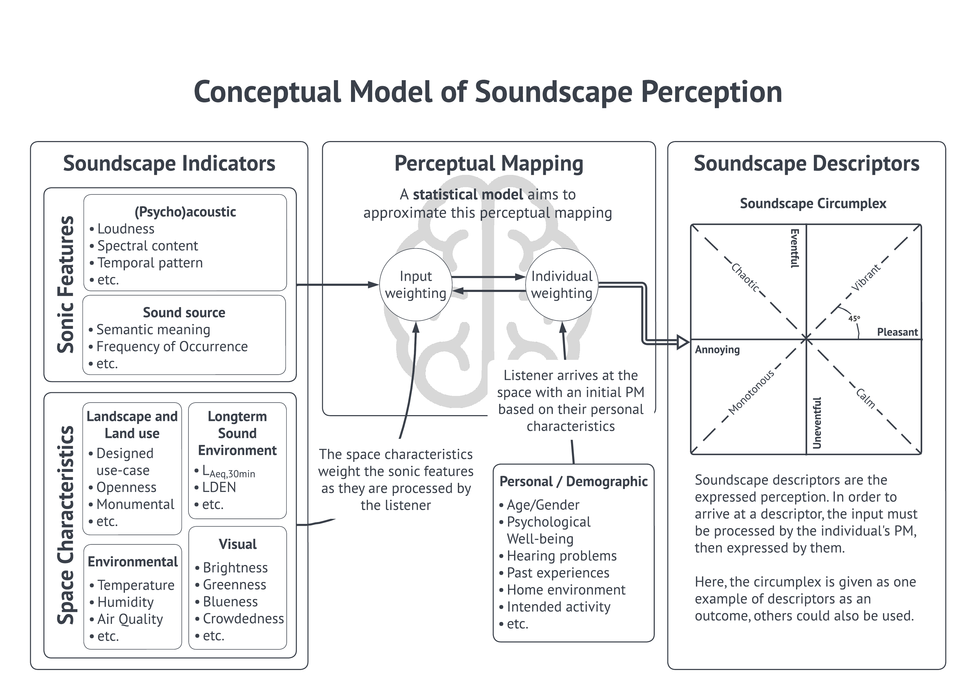
A. Mitchell, “Predictive Modelling of Complex Urban Soundscapes: Enabling an engineering approach to soundscape design,” PhD Thesis, University College London, 2022. doi: 10.13140/RG.2.2.15590.50245.

Slide 23
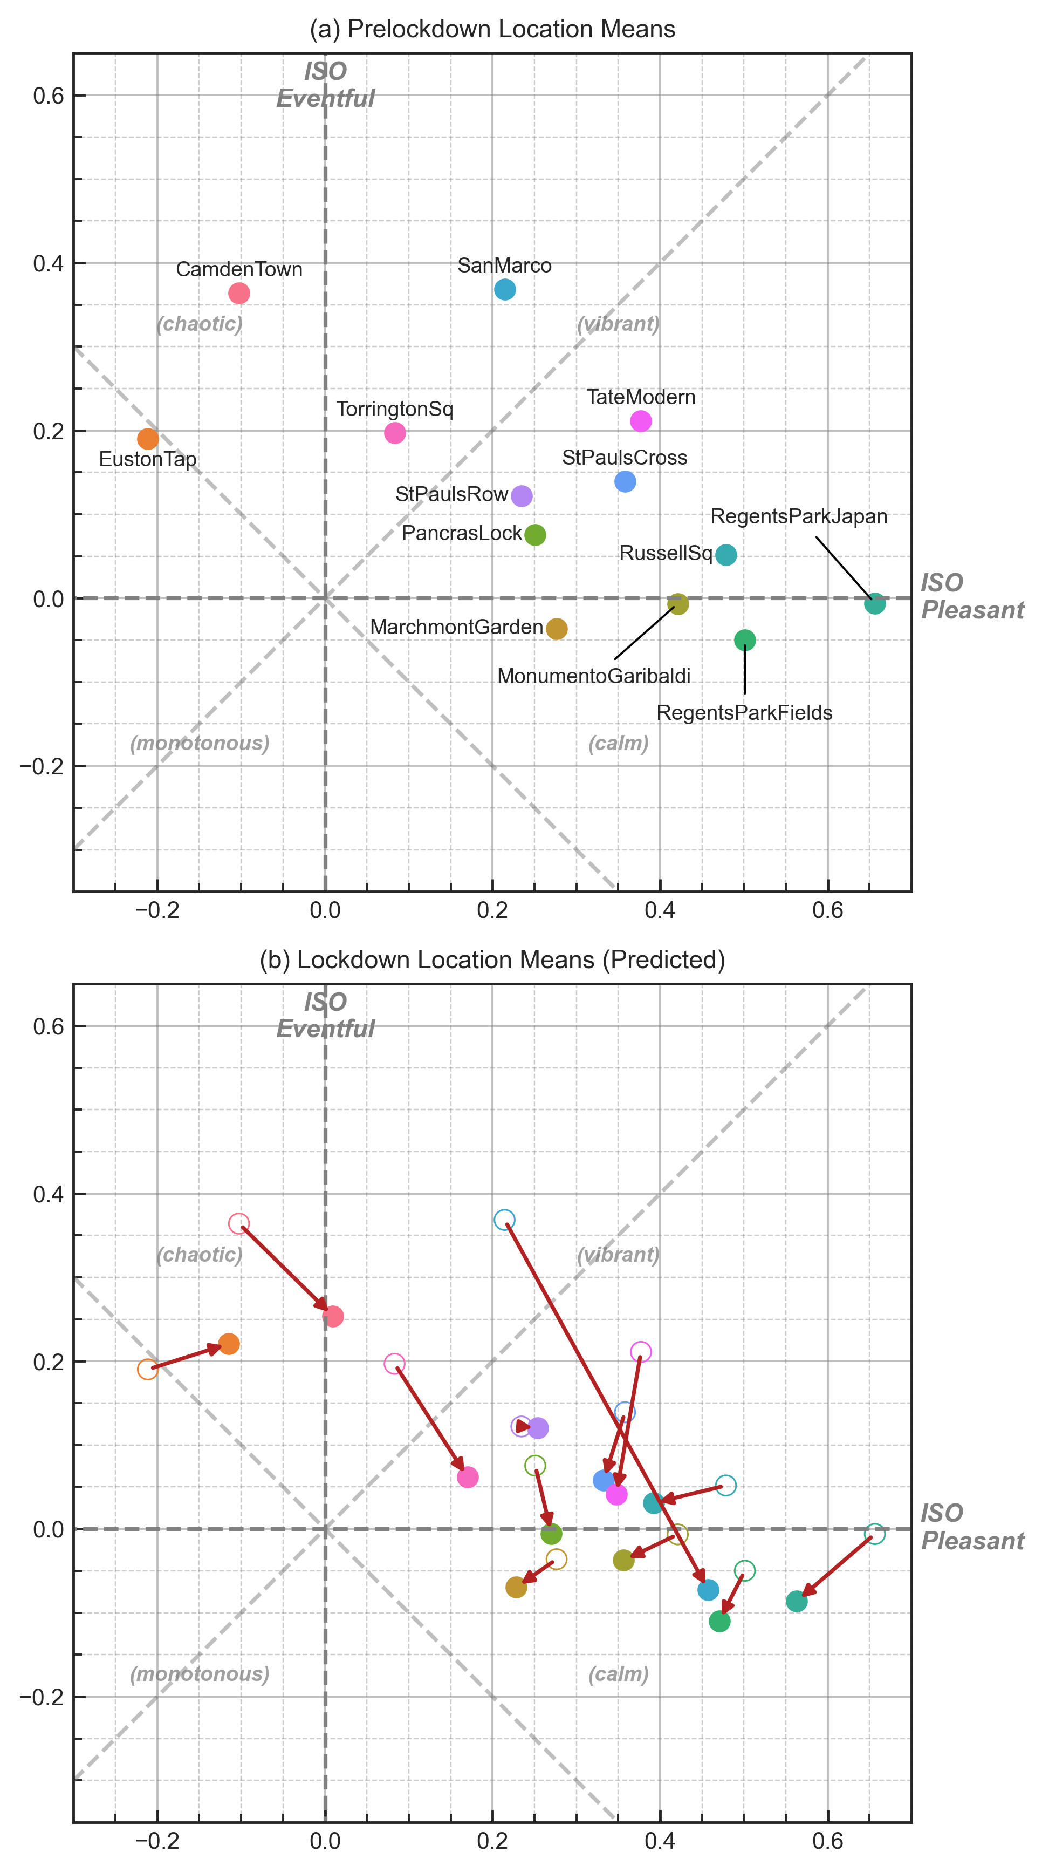
An application case study – COVID-19 Lockdown
From Mitchell et al. (2021). Investigating urban soundscapes of the COVID-19 lockdown: A predictive soundscape modelling approach. The Journal of the Acoustical Society of America, 150(6):4474-4488.
See also Watcharasupat, K., et al. (2022). Autonomous in-situ soundscape augmentation via joint selection of masker and gain. IEEE Signal Processing Letters, 29:1749-1753.

Slide 24
Measuring and Representing Soundscape Perception Data

Slide 25
Soundscape Database and Protocol
For more detailed information, see:
Mitchell, A.; Oberman, T.; et al.. The Soundscape Indices (SSID) Protocol: A Method for Urban Soundscape Surveys—Questionnaires with Acoustical and Contextual Information. Appl. Sci. 2020, 10, 2397.

Slide 26
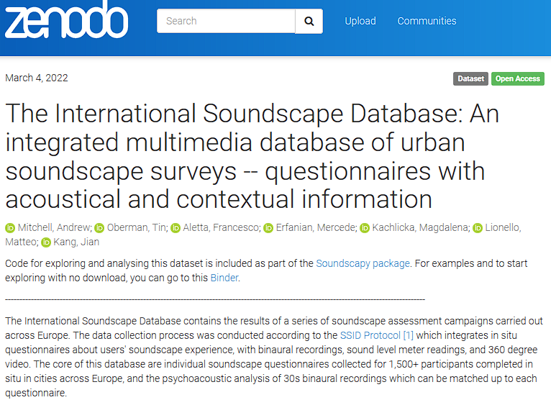
The International Soundscape Database (ISD)
To demonstrate the methods we’ll be talking about, we’ll use the ISD as an example
An initial version of the ISD has already been published on Zenodo. This version contains survey and acoustic data from 13 locations in London and Venice

Slide 27
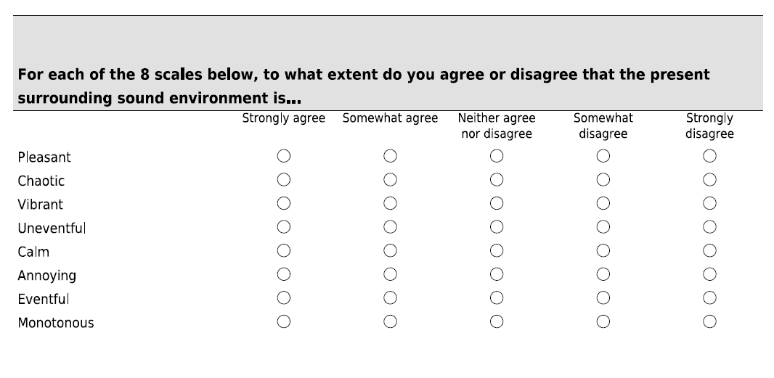
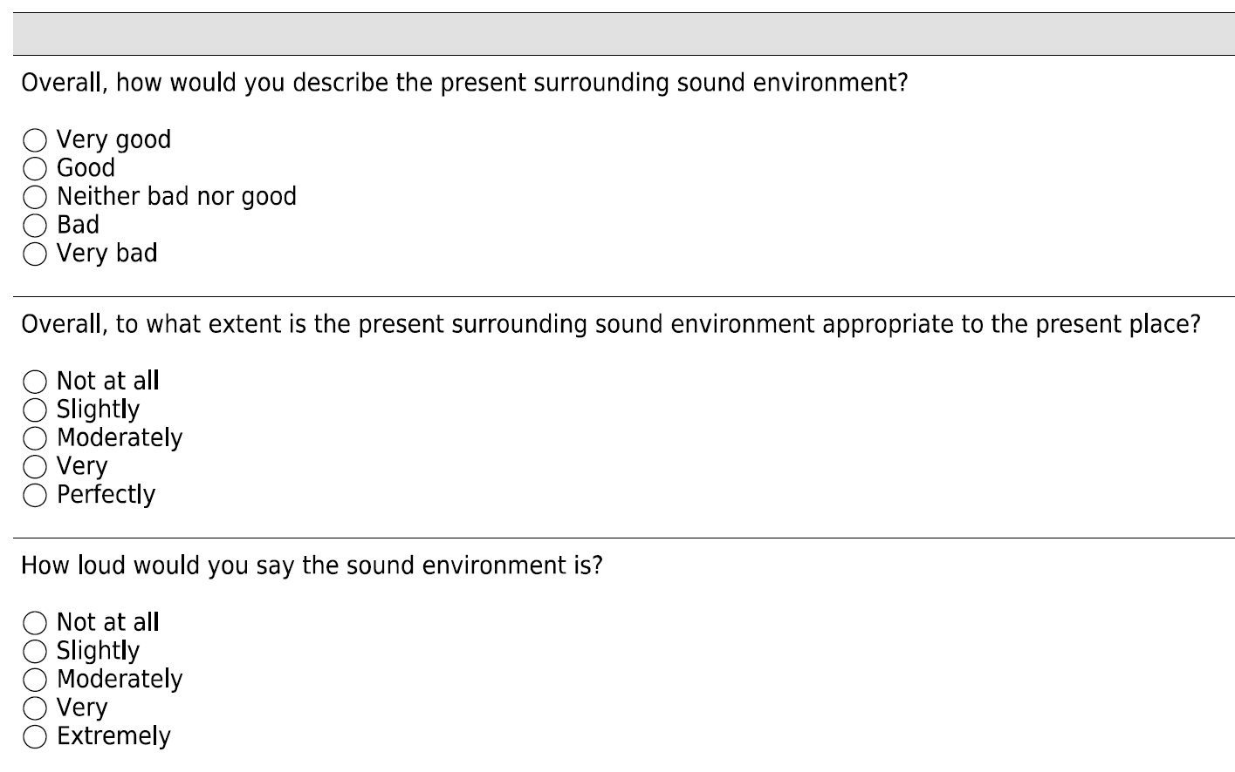
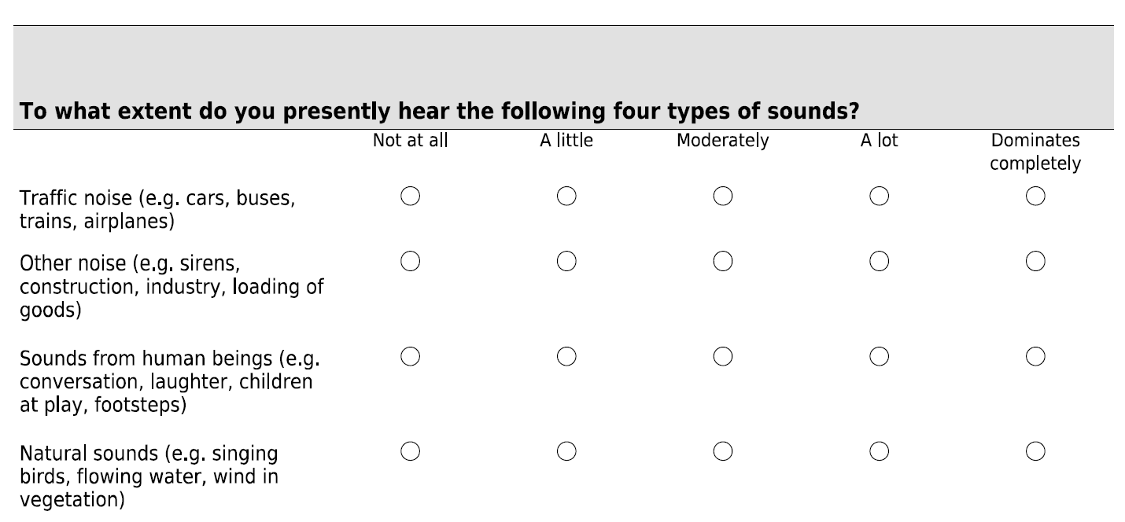
Perceived Affective Quality (PAQs)
Overall soundscape
Sound Sources

Slide 28
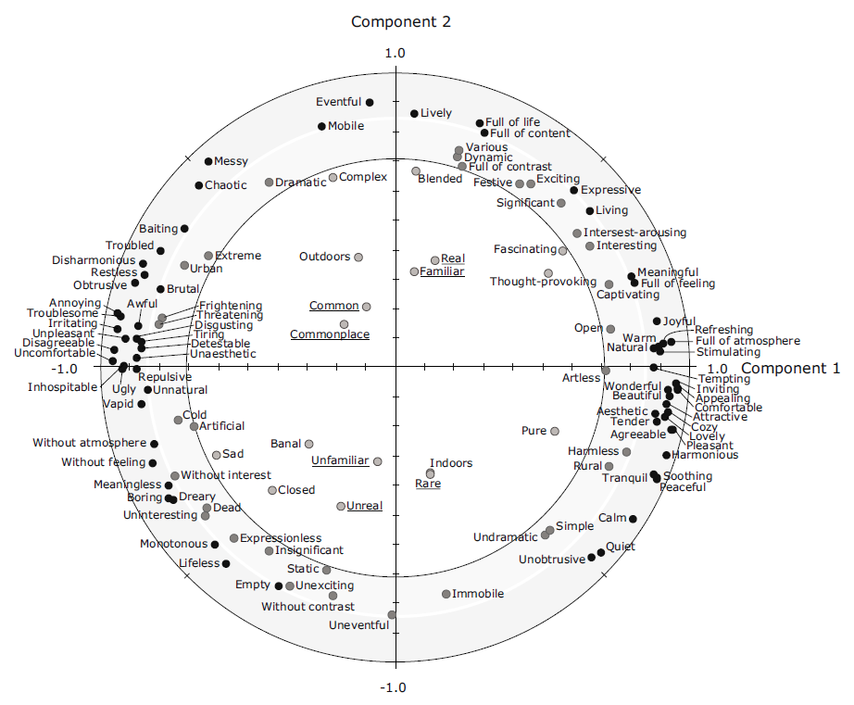
The Circumplex Model of Soundscape Perception
Axelsson, O., Nilsson, M.E., & Berglund, B. (2010). A principal components model of soundscape perception. The Journal of the Acoustical Society of America, 128(5), 2836-2846. doi.org/10.1121/1.3493436

Slide 29
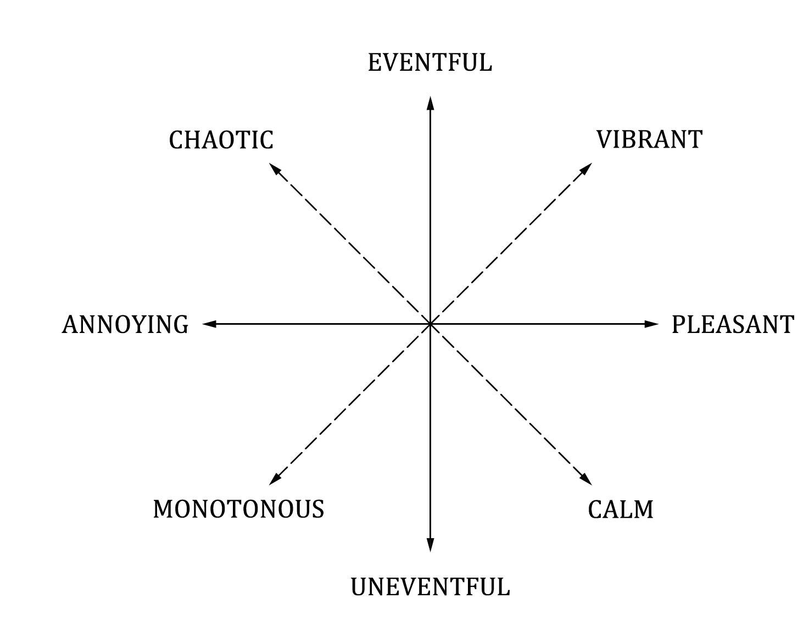
The Circumplex Model of Soundscape Perception
ISO/TS 12913-3:2019 Acoustics - Soundscape - Part 3: Data analysis

Slide 30
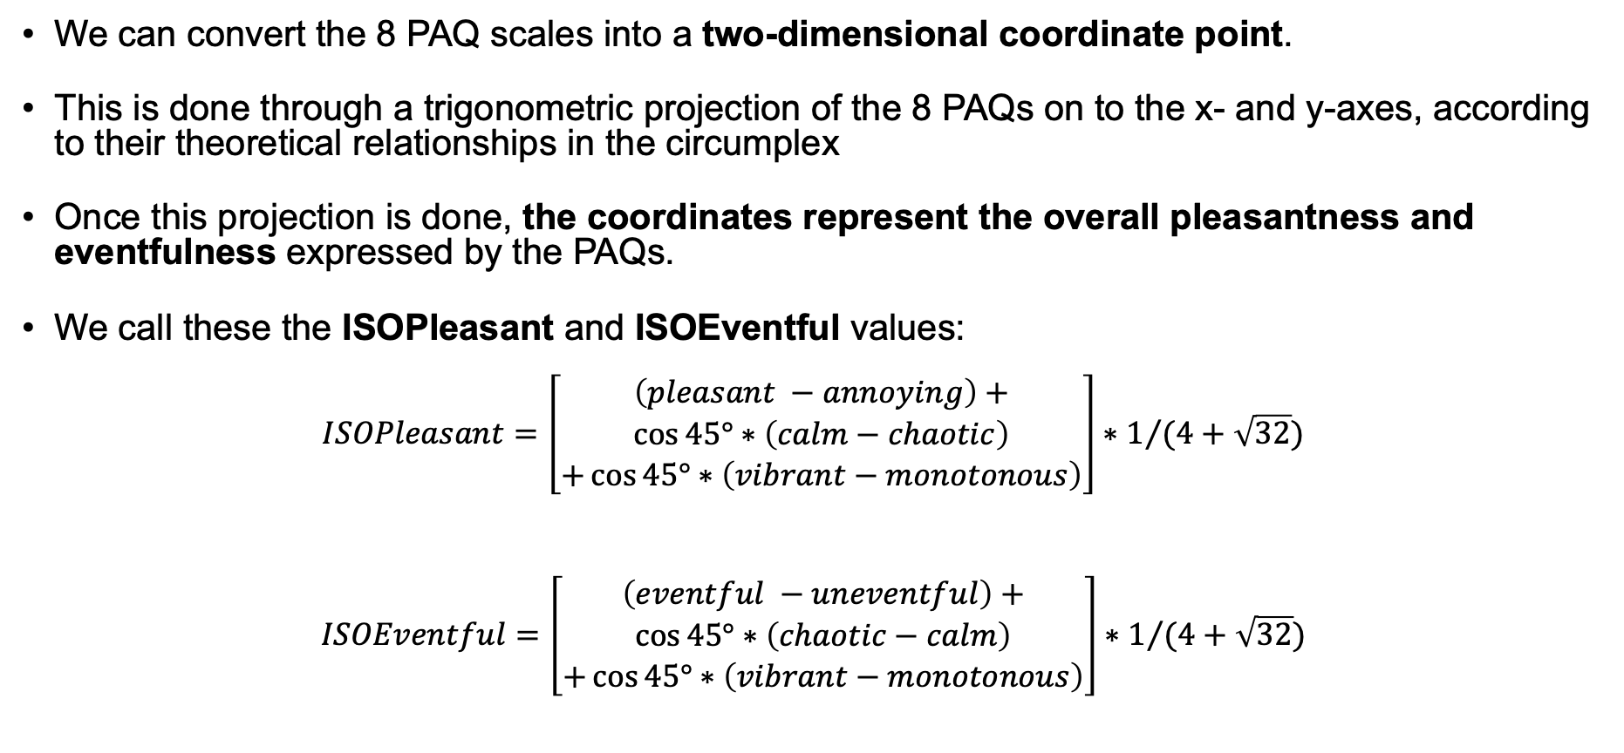
From PAQs to Circumplex Coordinates
We can convert the 8 PAQ scales into a two-dimensional coordinate point.
This is done through a trigonometric projection of the 8 PAQs on to the x- and y-axes, according to their theoretical relationships in the circumplex
Once this projection is done, the coordinates represent the overall pleasantness and eventfulness expressed by the PAQs.
We call these the ISOPleasant and ISOEventful values:
$ISOPleasant=\left[\begin{aligned}\begin{aligned}\left(pleasant −annoying\right)+ \\ \cos{45°}∗\left(calm−chaotic\right)\end{aligned} \\ +\cos{45°}∗\left(vibrant−monotonous\right)\end{aligned}\right]∗1/{(4+\sqrt{32})}$
$$ISOEventful=\left[\begin{aligned}\begin{aligned}\left(eventful −uneventful\right)+ \\ \cos{45°}∗\left(chaotic−calm\right)\end{aligned} \\ +\cos{45°}∗\left(vibrant−monotonous\right)\end{aligned}\right]∗1/{(4+\sqrt{32})}$$

Slide 31
How to describe the diversity of perceptions in a group?
In order to characterise the soundscape of a particular space or time, perceptual responses from multiple people must be collected and subsequently summarised to describe the general soundscape of the location
The soundscape survey methods and the ISO were originally developed for characterising the perception of an individual.
No location, setting, or even single sound will have an identical, single perception across a population. This should be reflected in our representation of soundscape perception.
However, the soundscape of a place could be more accurately described as a collective perception.
By definition, this collective perception should consider the diversity of people’s perception.

Slide 32
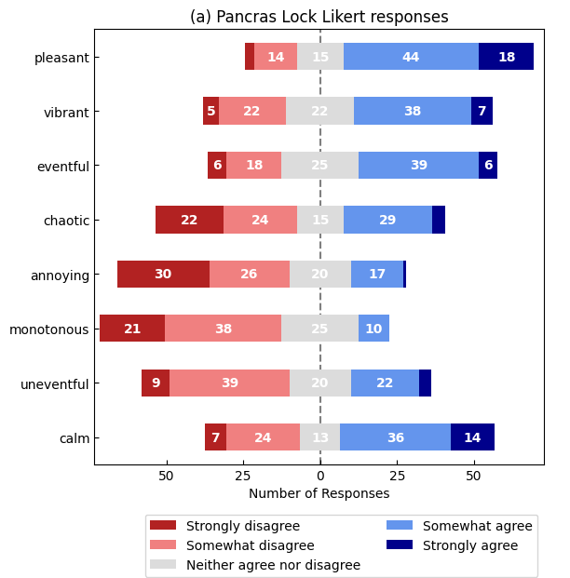
Soundscape Density Plots
First: Calculate the coordinates of each individual response

Slide 33
Soundscape Density Plots
First: Calculate the coordinates of each individual response
Second: Treat these results as a vector of ISOPleasant, ISOEventful values which are continuous variables from -1 to +1 and can be analysed statistically

Slide 34
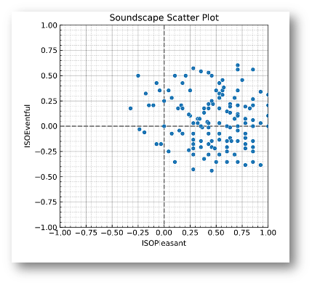
Soundscape Density Plots
First: Calculate the coordinates of each individual response
Second: Treat these results as a vector of ISOPleasant, ISOEventful values which are continuous variables from -1 to +1 and can be analysed statistically
Third: Plot these coordinates as a scatter plot

Slide 35
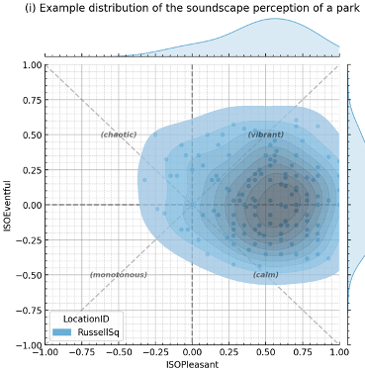
Soundscape Density Plots
First: Calculate the coordinates of each individual response
Second: Treat these results as a vector of ISOPleasant, ISOEventful values which are continuous variables from -1 to +1 and can be analysed statistically
Third: Plot these coordinates as a scatter plot
Finally: Overlay a density heatmap and marginal distribution plots to examine the shape and distribution of the location

Slide 36
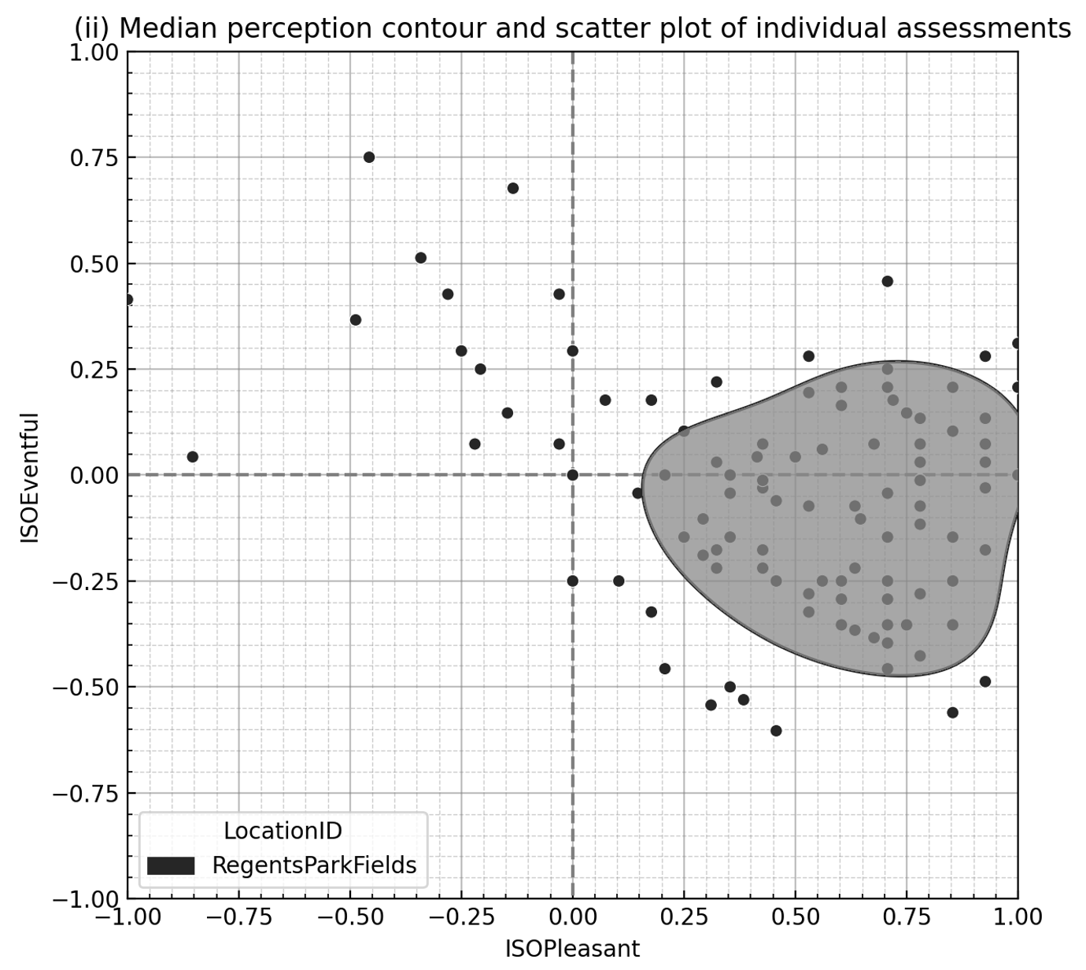
Simplified distribution for comparisons
While the decile heatmap provides a lot of detailed information, the detail can make further analysis difficult.
We propose using a simplified version which only plots the 50th percentile contour.

Slide 37
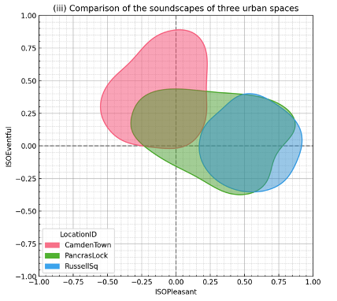
Simplified distribution for comparisons
The greatest benefit of this is seen when comparing multiple locations

Slide 38
Proposals
Putting all of this into practice

Slide 39
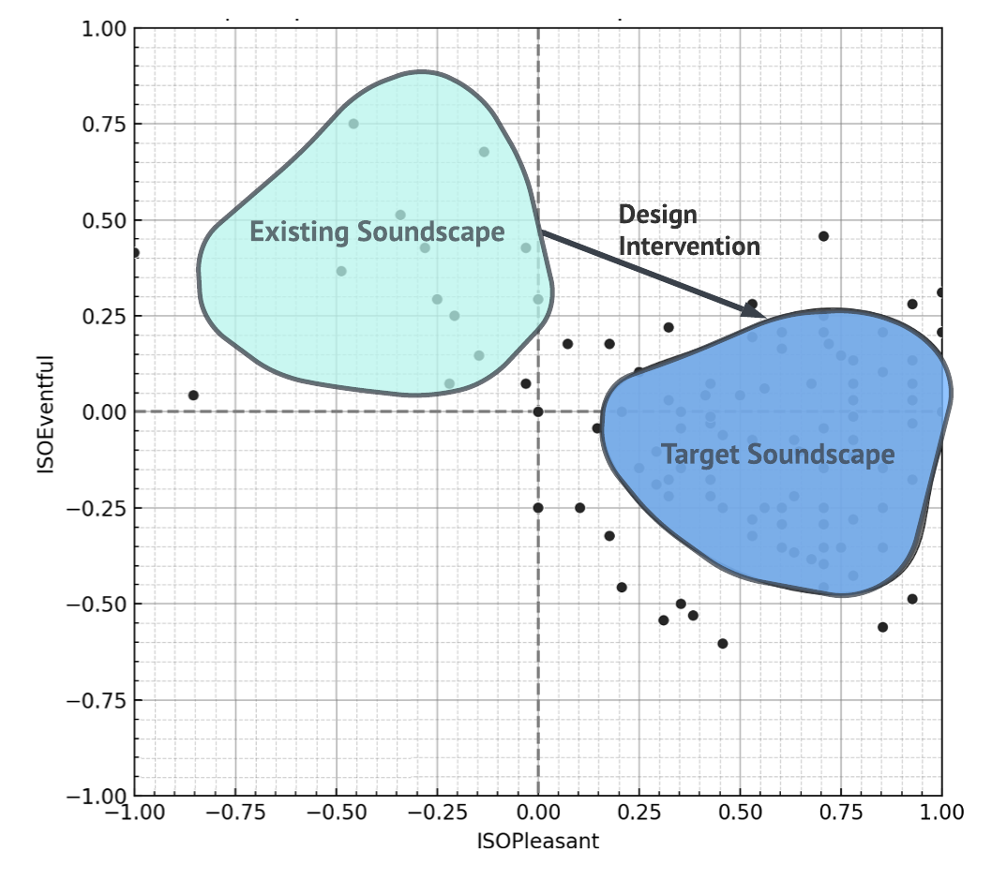
Making use of the predictions in design
Once the existing soundscape distribution is established (through prediction or surveys) the designer then defines their goal or target soundscape.
By creating design proposals and running them through a PSM, the success of the proposal for achieving the target can be assessed.
With a PSM which meets the defined goals & constraints, we can trial various designs to optimize and assess their success.
Adapted from Cain, R., Jennings, P., & Poxon, J. (2013, Feb.). The development and application of the emotional dimensions of a soundscape. Applied Acoustics, 74(2):232-239.

Slide 40
Towards Soundscape Indices
Within the practicalities of built environment projects, the consequences and successes of a design often need to be quantifiable within a single index.
This necessitates the creation of consistent and validated indices which indicate to what degree a proposed design achieves the design goal.
This presents two primary challenges:
How to summarise the two-plus dimensions of soundscape perception into a single index.
How to allow for various contexts and different design goals.

Slide 41
Soundscape Indices for Mapping & Monitoring
A preliminary example of soundscape index (SSID) mapping.
Mapping soundscape vibrancy based on PAQs from surveys collected in Nantes.
The survey collection is extremely labour-intensive and results in low spatial resolution. A PSM would allow these responses to be predicted from sensor recordings.

Slide 42
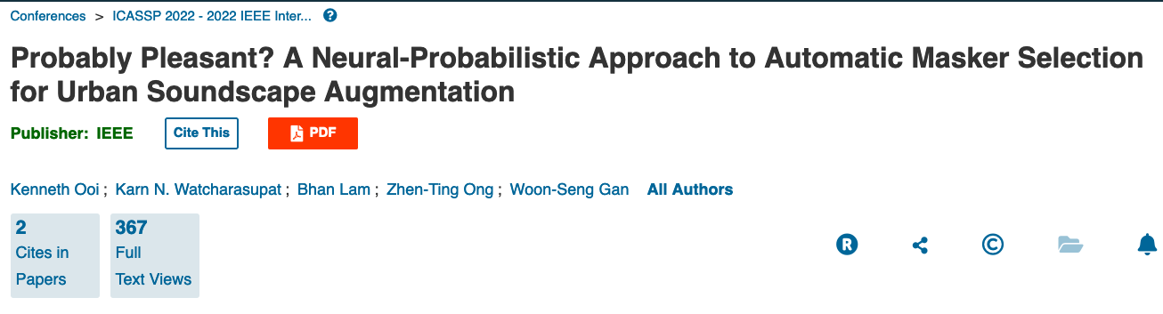
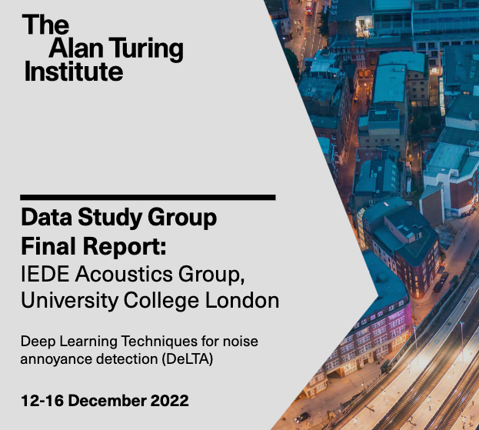
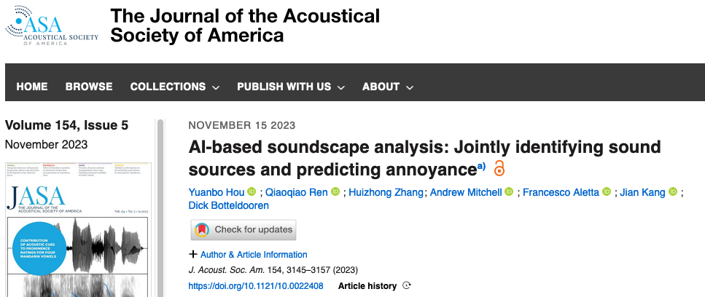
Developing New Predictive Models

Slide 43
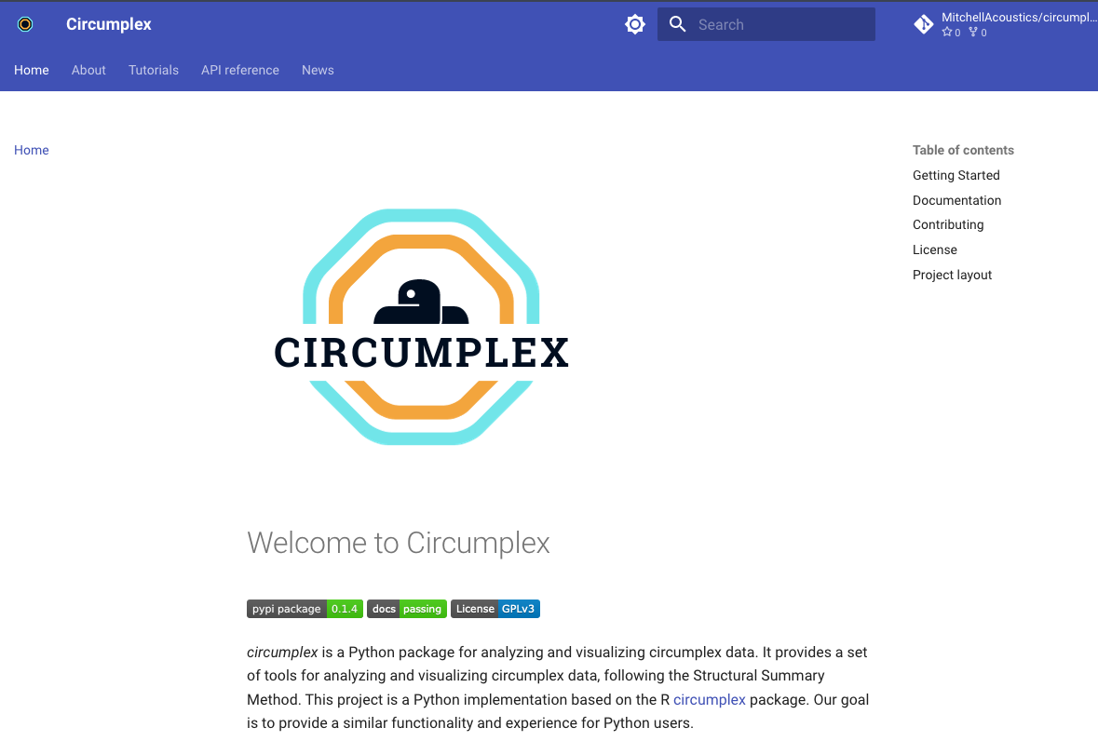
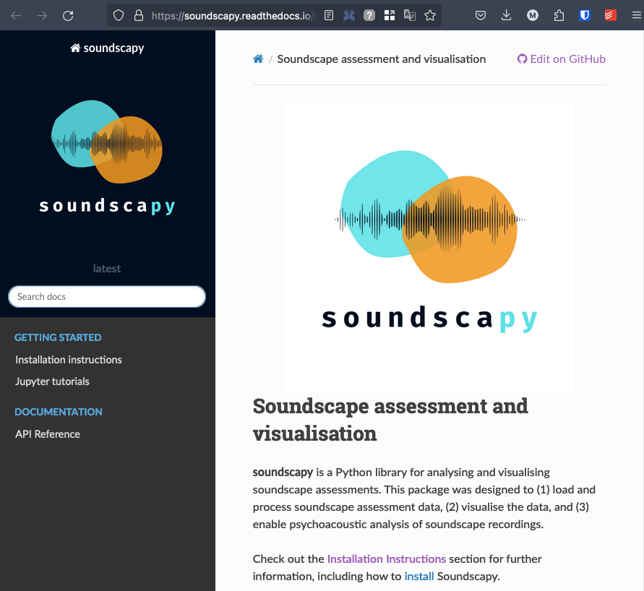
Open Source Packages
https://soundscapy.readthedocs.io/en/latest/
https://circumplex.readthedocs.io/en/latest/

Slide 44
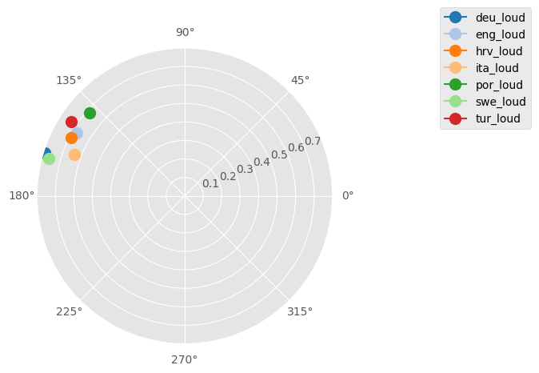
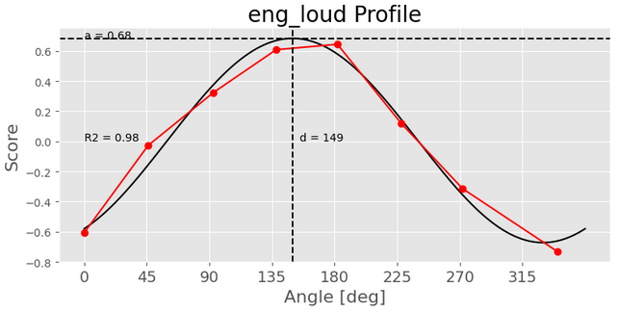
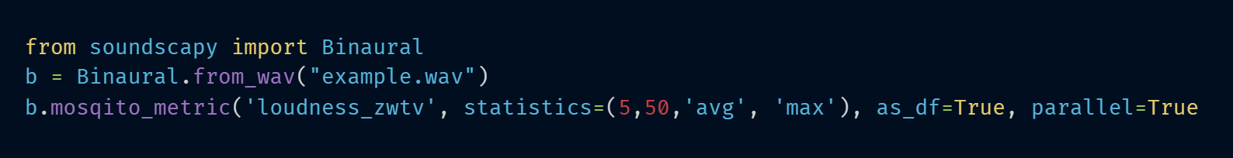
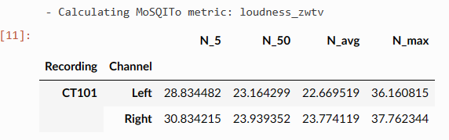
Open Source Packages
Soundscapy:
Psychoacoustic and Eco-acoustic Analysis
Circumplex:
Advanced circumplex analysis
In addition to making it simpler to work with soundscape survey data, Soundscapy makes it easier to perform bulk analysis of binaural recordings.
By providing a streamlined and repeatable frontend to analysis libraries such as MoSQito, scikit-maad, and python-acoustics, we make it possible to calculate a wide range of metrics from psychoacoustics, eco-acoustics, and environmental acoustics with consistent settings
Calculation settings can be saved and shared in a JSON file.
Parallel calculations drastically speed up bulk processing.
Implements the Structural Summary Method (SSM) of circumplex analysis.
This enables more detailed analysis of circumplex items, correlation with external variables, and validation of the circumplex structure of responses.
Extended to any circumplex survey instrument

Slide 45

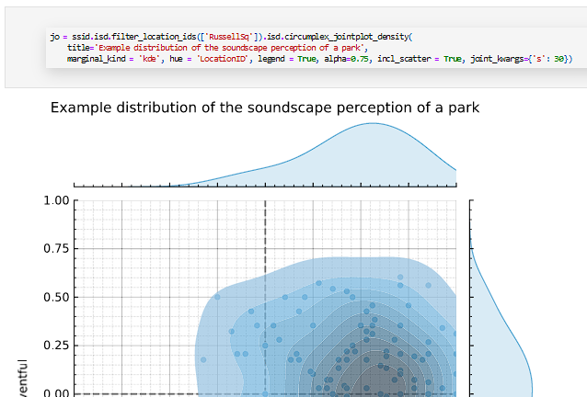
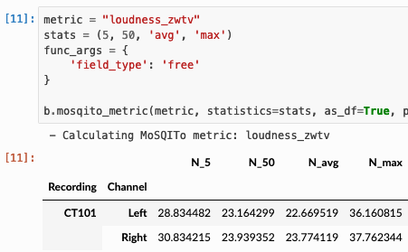
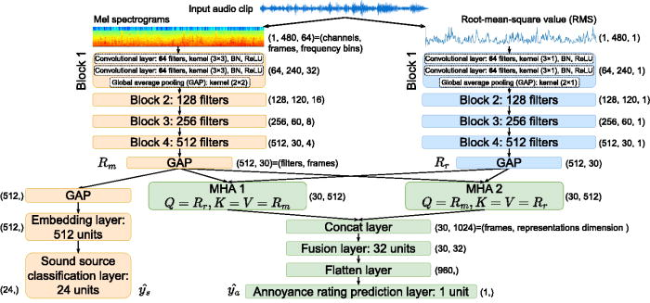
Putting it all together
Free and Open Source
Modular and Adaptable
Audio analysis
Psychoacoustics, environmental acoustics, bioacoustics, etc.
Predictive Modelling
Multi-level Linear Regression
Probabilistic Predictions
Joint Source-Perception Modelling
Visualisation & Scoring
Soundscape Density Plots
Soundscape Indices
Setting Design Goals

Slide 46
Thank you for listening
Dr Andrew Mitchell, Senior Research Fellow, UCL IEDE
andrew.mitchell.18@ucl.ac.uk
https://drandrewmitchell.com

